Slide 1
My name is Eugene cabrera, I’m designing and developing an application that is a tool to help family maintain communications daily. Done through an application that has the basic daily task list your every family has. Like chores, grocery list and setting reminders. Being a parent I know how technology is changing everyday life and making it better in one or the other. Using this application helps keep every family member in the loop with getting all daily task completed so that there’s enough time spent as a family rather than working around the house.

Slide 2
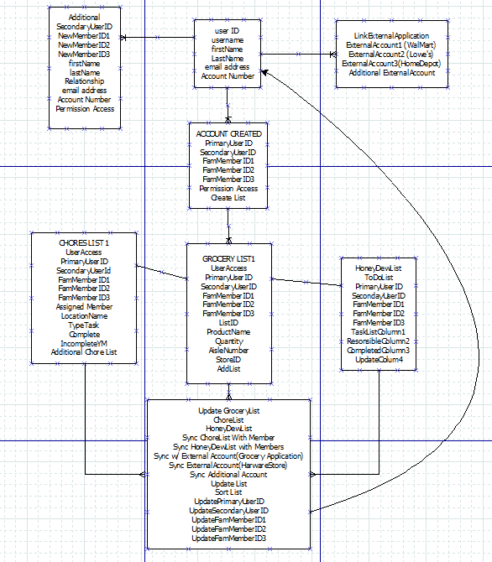
HoneyDew Application Project
Design process
Program Layout
Basic Concept to communicate and assign task as it arises
HoneyDew Requirements:
Account set up
Able to add additional member
Link account to a WalMart Application
Generate list/chore list

Slide 3
Analysis
Functional requirements
Able to generate common list
Communicate with all members
Update list as completed
Non-Functional Requirements
Able to provide updates as tasks are complete

Slide 4
HoneyDew
List
Grocery
Upcoming Reminders
List
Jalapeno
Milk
Eggs
Bacon
Orange Juice
Steak
Chicken
Etc…..
Reminder:
Pick up suit/Location/Time
Bring things to work
PTA mtg/school/time
Shopping
Chores
Sync with Calendar
Linked to WalMart (OrangePark)
Add Member
Reminder
View Calendar
Add Member
Random Ad
Random Ad

Slide 5



Chores
NeverEnding Chores
BigBrother
BigBrother
Make Bed
Daily
Take Trash
Daily
Make Bed
Take Trash
Sweep
Weekly
Sweep
Homework
HomeWork
Monthly
Weekly
Add Member
Trash
Recycle
Field day
PT
Update Status
Update Status
Update Status

